Slide 1
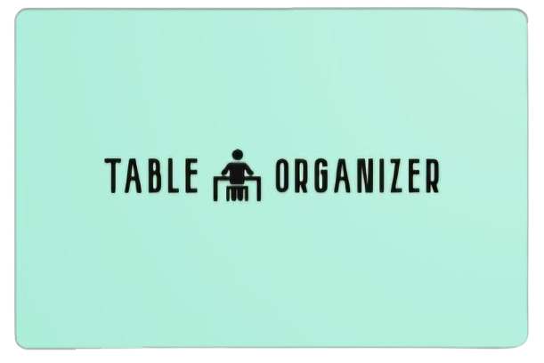
Uri ziv, Michal Shechter, Nadav Sananes

Slide 2

How many people were at your Passover evening?
And how long it took you to decide who sits where?
we wanted to solve this problem in one easy click (or maybe just a little bit more)
All you have to do is to take a picture of your table and tell us who is the annoying aunt you want to sit away from you, and who is inseparable.

Slide 3
How does it work?
01
02
03
04
Detecting the table’s seat layout
Adding guest names
And constrains
Using label relaxation
Returning the best
sitting arrangement

Slide 4
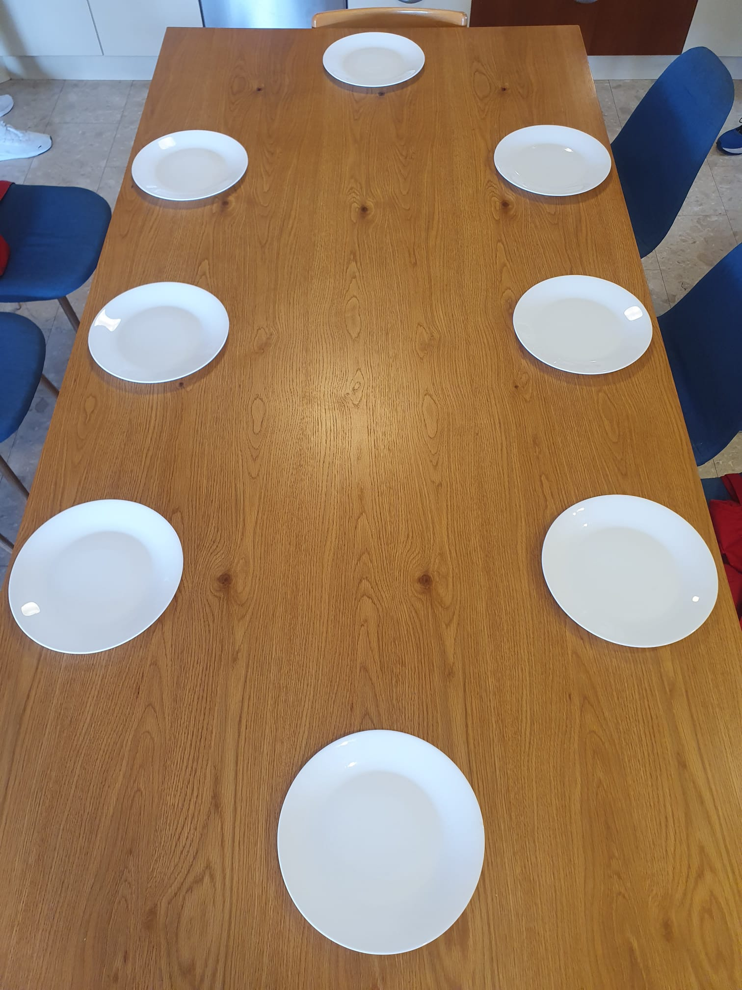
Stage 1: Detecting the table’s seat layout
Using an image of the dining table, we want to find:
How many seats there are
Which seats are next to each other
Which seats are across one another
How? By detecting the plates on the table!

Slide 5
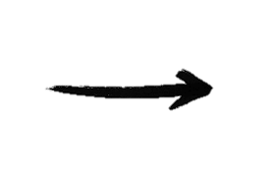
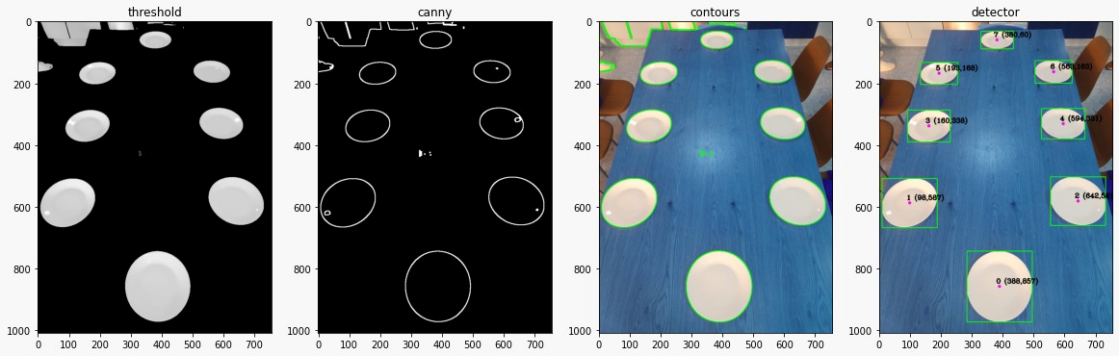

Plates detection
Setting a threshold
Canny edge
detector
Finding contours
Finding the plates

Slide 6
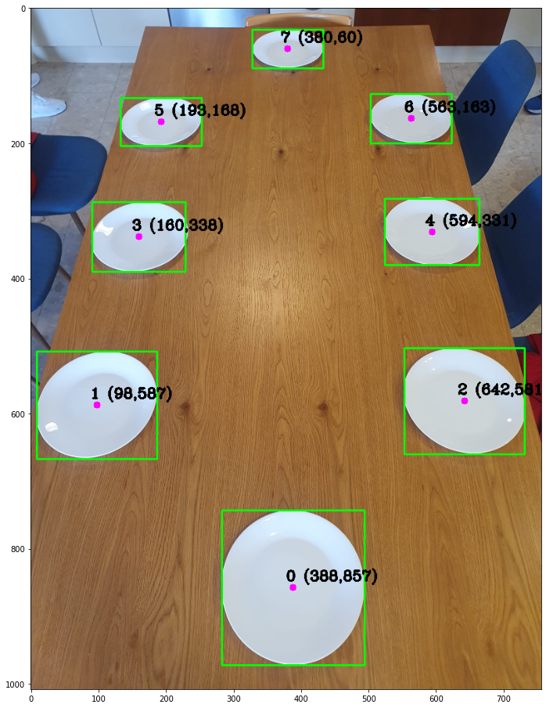
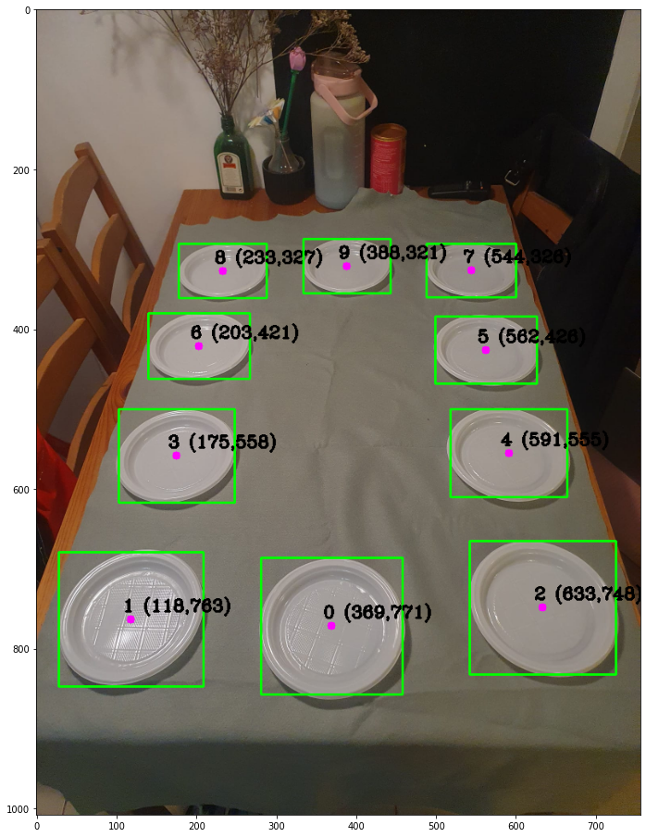
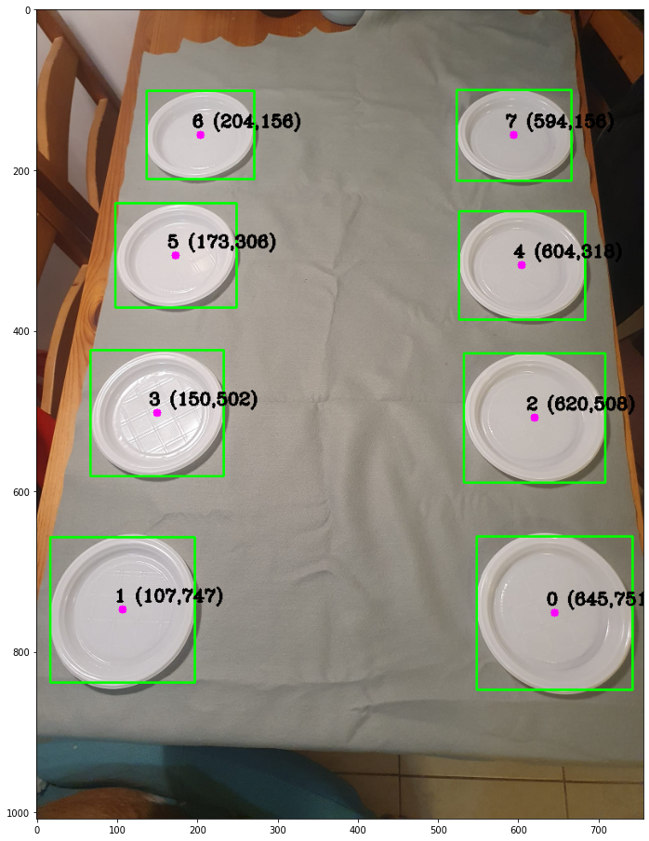
Detector Results

Slide 7
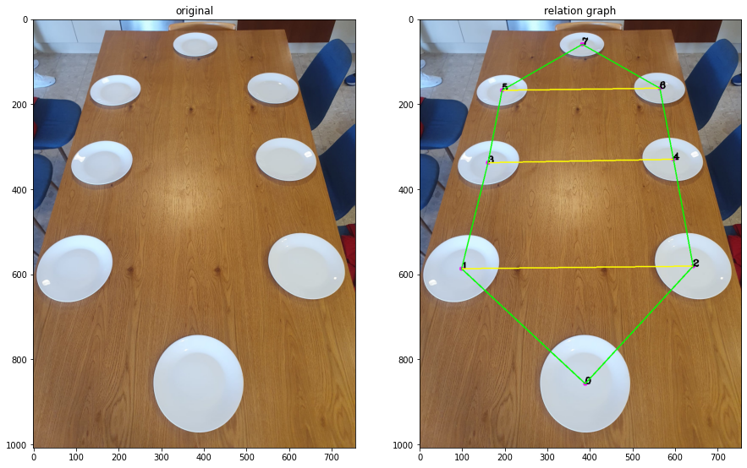
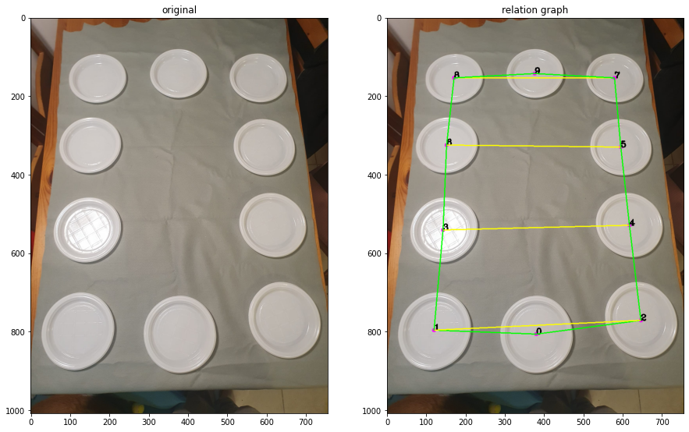
Relations between seats
= near
= across

Slide 8
Stage 2: Adding guest names and constraints
The user enters names of the guests around the table.
Paying attention to the number of detected spots
The user also provides pairs of people who want to sit together, or sit far away from each other (for example – your boyfriend wants to sit next to you, but not your father…)
We build a symmetrical constraints matrix to represent the relationships between the people

Slide 9
Stage 3: using label relaxation
Using an adaptation of the Relaxation Algorithm we learned in class, we find the best overall sitting arrangement
We picked the
Guest names
To be the Labels
And the
Sitting spots
To be the Objects
The original order of insertion is the initial assignment
Unlike the original algo, assigning a label to 2 different objects is not allowed

Slide 10
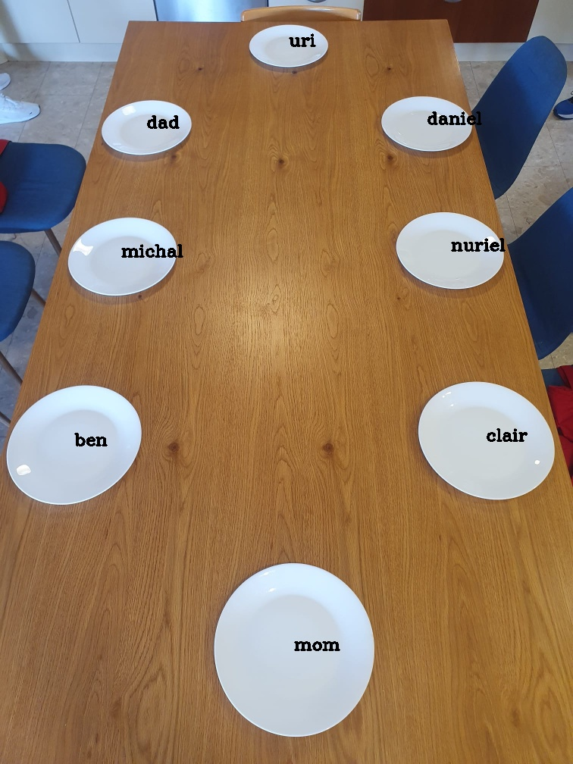
Stage 4: finding the best arrangement
We find the best arrangement possible according to the constraints
We can’t promise everyone will end up happy, but we sure try…

Slide 11
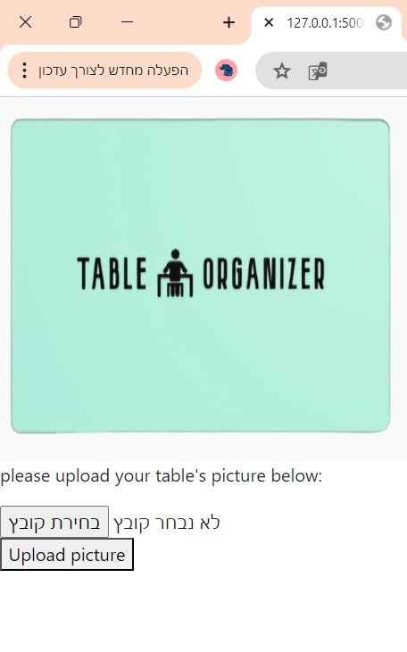
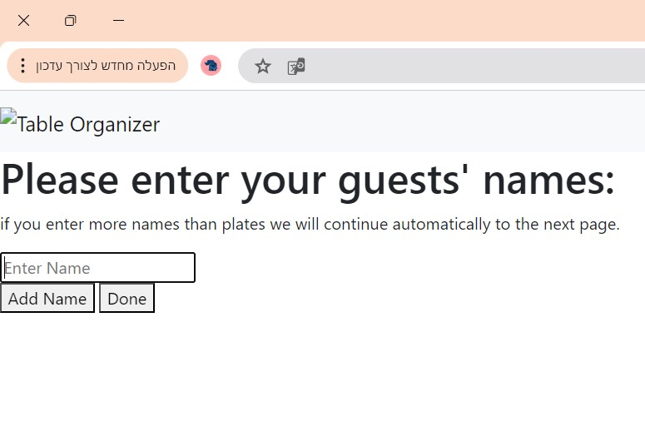
User Interface: Flask Website

Slide 12
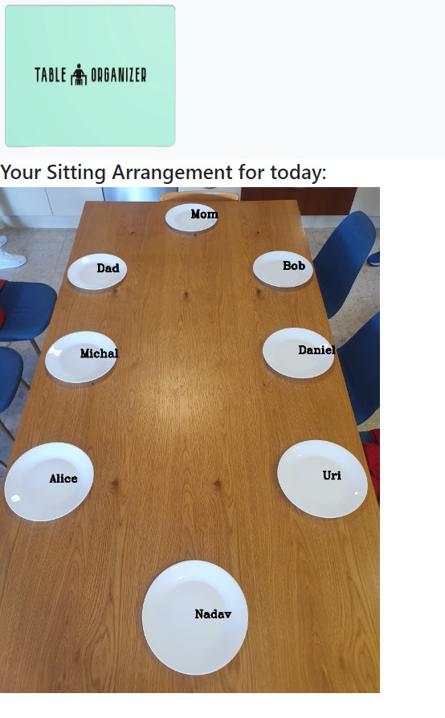
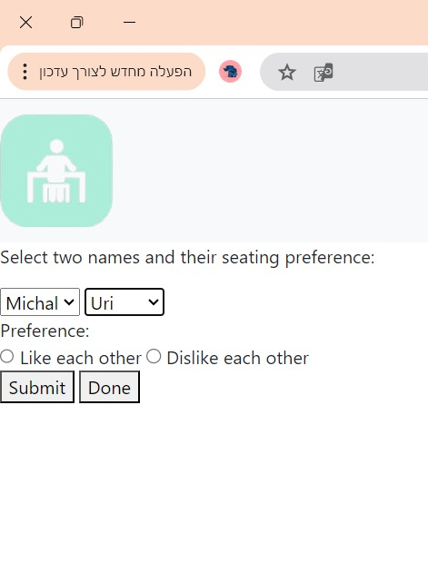
User Interface: Flask Website

Slide 13
Thanks for listening!

